Slide 1

EXPLORING THE
CAR SUBSCRIPTION
MARKET
Anastasopoulos Giannis
Petrou Nikos

Slide 2






The Team
ANASTASOPOULOS GIANNIS
PETROU NIKOS
BSc in Business Administration
Financial Controller
MSc in Agricultural Economics
MSc in Bioeconomy
01 - BRANDING

Slide 3
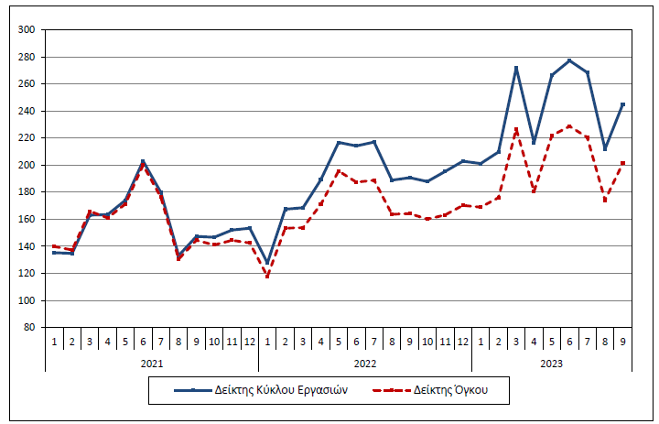
Car market in Greece
Rising market
Car Subscription Model
Flexible car switching
Little to no down payments
Monthly subscription fee
Return car at any moment
Source: Hellenic Statistical Authority, 2023

Slide 4
Project Overview
Project Pipeline
Analysis & Insights
Live Demo - Car Searching Tool
Recap & Next steps

Slide 5
Project Roadmap & Tools
Web Scraping
Data Cleaning & Processing
EDA
Visualization
Insights
Week 1
Week 2
Web Scraping
Tools used: Python [ Beautifulsoup, Selenium ]
4 Companies (Avis, FlexCar, Instacar, Finn)
4K Cars
8 Characteristics
Data Cleaning & Processing / EDA
Tools used: Python [ Pandas, Numpy ]
Price Adjustment
Corrections of brand and model names
Visualization & Insights
Tools used: Python [ Matplotlib, Seaborn, Plotly ]
Power BI

Slide 6
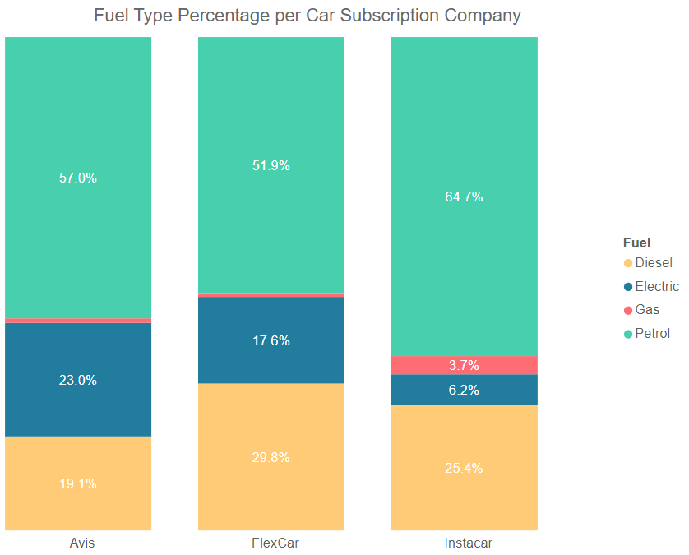
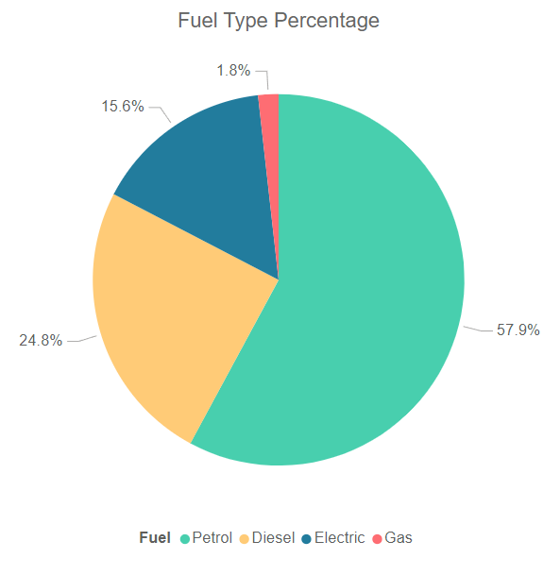
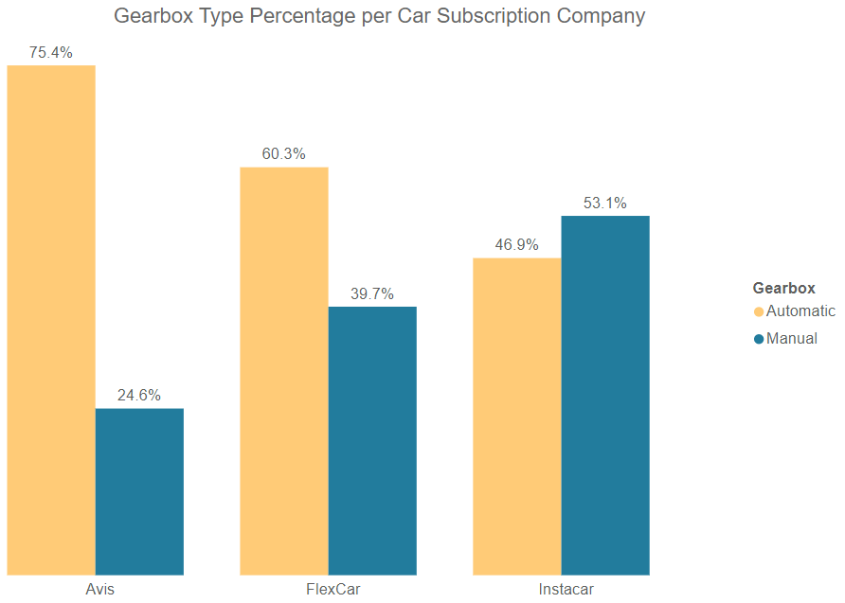
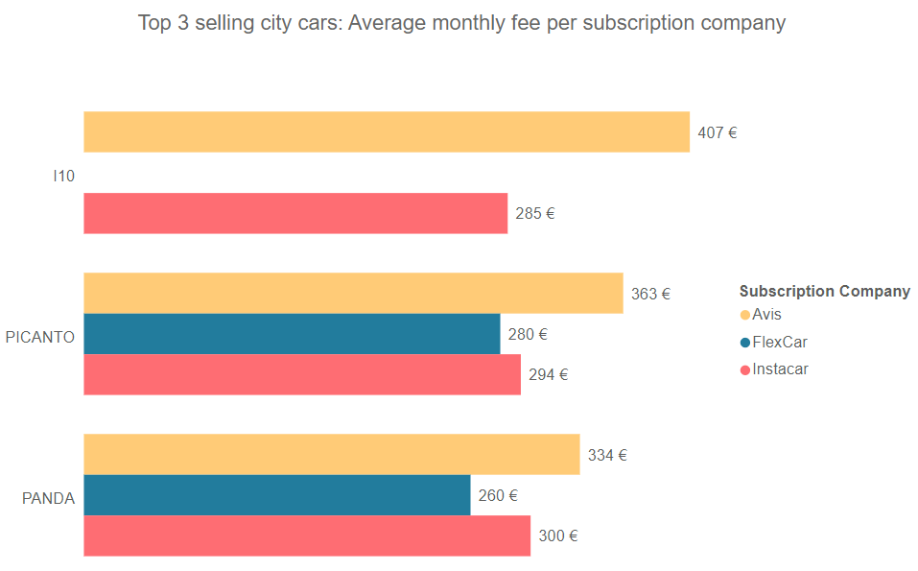
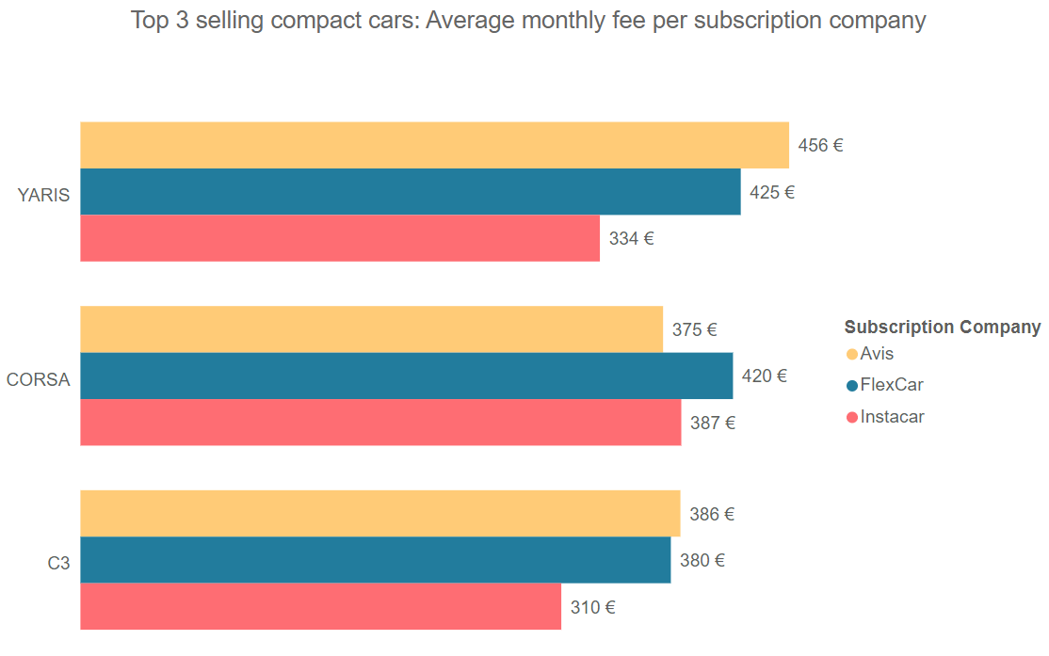
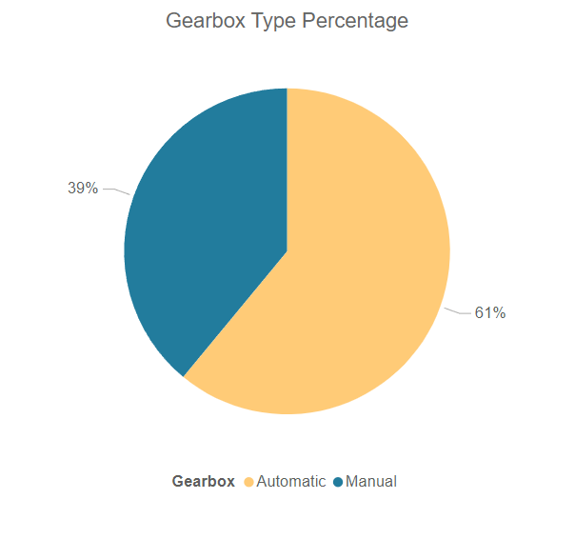
Insights
Greek car subscription companies offer more automatic than manual cars
Petrol is the most common fuel type among car subscription companies’ cars
FlexCar doesn’t offer one the most popular city cars
Instacar offers 2 / 3 of the top selling compact cars in lower average monthly fee

Slide 7
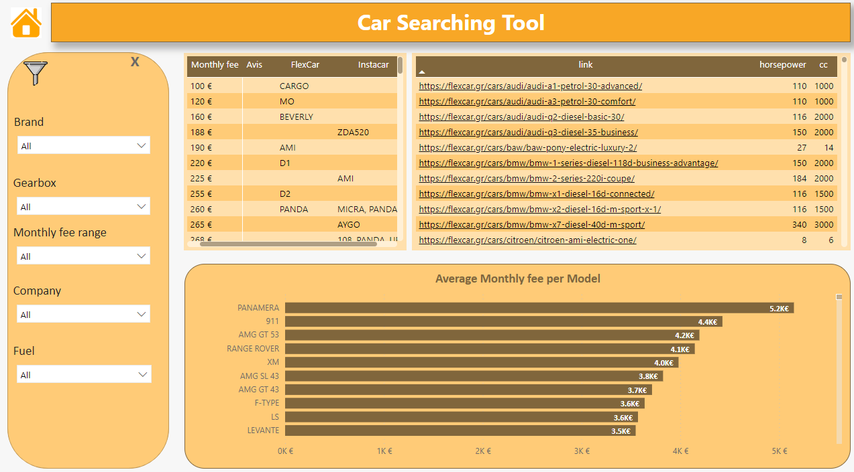
Car Searching Tool

Slide 8
Project Recap
Insights for the greek car subscription market
Development of a car searching tool
Analysis of a german subscription company & comparison with the greek market
Next Steps
Optimization of the scraping process
Data acquisition for more companies in Greece and abroad
Development of a car searching tool for foreign markets

Slide 9


Thank you for your attention!
Anastasopoulos Giannis
Petrou Nikos
Lorna Alvarado

